Slide 1
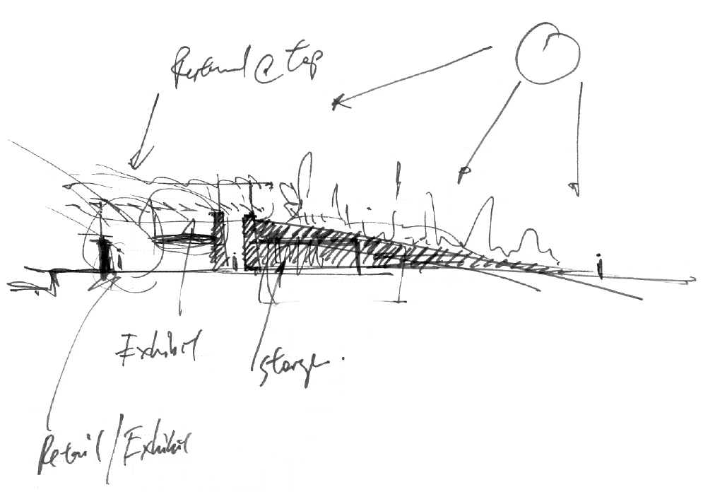
2018 ASHRAE LowDown Showdown Modeling Competition
2018 Building Performance
Analysis Conference and SimBuild
43 | 40
$$\lim_{x→∞}$$
Taking energy modeling to the
September 27, 2018

Slide 2
PROJECT SUMMARY
Green field
Solar park
Light done right
Precision comfort
2018 ASHRAE LowDown Showdown Modeling Competition

Slide 3
PROJECT SUMMARY
EUI = 40.7 kWh / m²
Annual utility cost = 4840 $/yr
Simple payback: 35 years
What makes our project special
Collaborative workflow
Optimized design
In-house integrated disciplines
ARCHITECTURE + ENGINEERING
= NET ZERO
2018 ASHRAE LowDown Showdown Modeling Competition

Slide 4
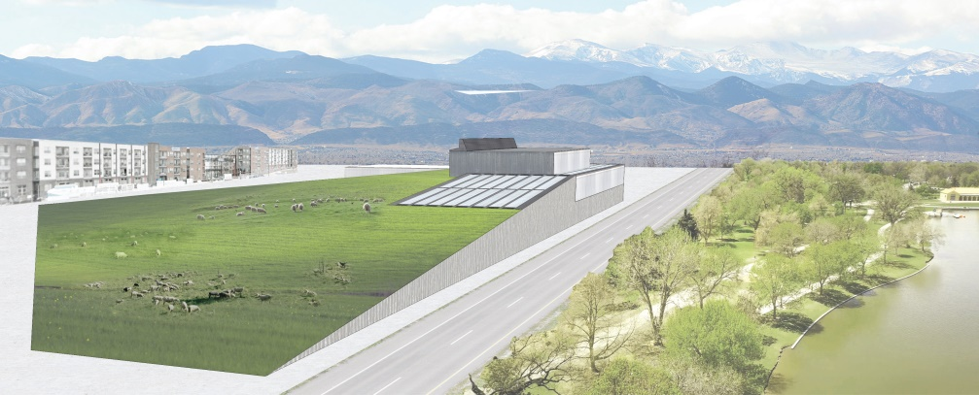
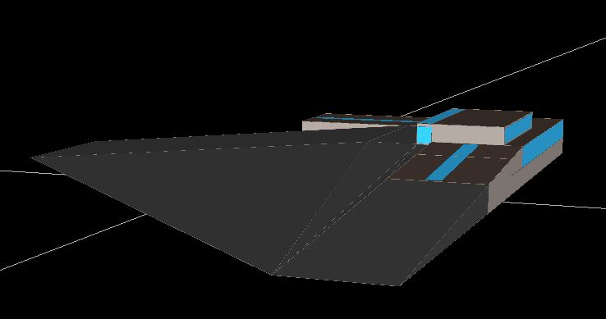
ENERGY EFFICIENCY – THE WORKFLOW
Front-end loaded design
Design using Autodesk
Detailed energy modeling
Tailored analysis
2018 ASHRAE LowDown Showdown Modeling Competition

Slide 5
ENERGY EFFICIENCY – THE MEASURES
Site
Green roof
Envelope
Daylighting
Demand control ventilation
Ground source VRF
Geoexchange
2018 ASHRAE LowDown Showdown Modeling Competition

Slide 6
ENERGY EFFICIENCY – THE SOFTWARE
2018 ASHRAE LowDown Showdown Modeling Competition

Slide 7
WELL MEASURES
WELL and energy were both considered
Difficulties: Feature 21 and CFD
2018 ASHRAE LowDown Showdown Modeling Competition
Notes:
- WELL measures were considered in advance
- measures were selected considering WELL and energy
- e.g. daylighting, VRF, DCV, natural ventilation
- difficulties: feature 21 suggests computational fluid dynamics analysis; this is onerous and was not completed
- typically, there was positive alignment betweel WELL features and energy efficiency
- costs were captured in ECM capital cost estimates
- clarity varied depending on the feature
- e.g. lighting features were straighforward
- ventilation features were more convoluted

Slide 8
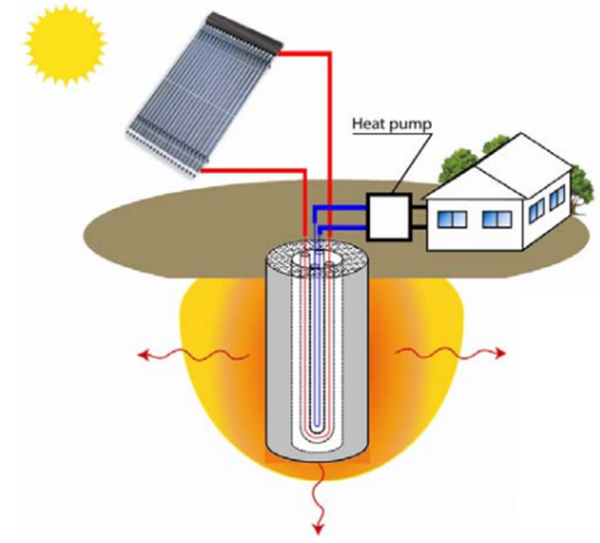
NOVELTY: GEO-SOLAR
THERMAL STORAGE
Heating demand > cooling demand
Solar thermal energy recharges ground
Maintains system efficiency
Ground source VRF integral to efficiency and comfort
2018 ASHRAE LowDown Showdown Modeling Competition

Slide 9
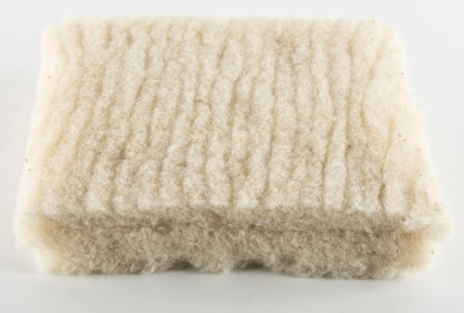
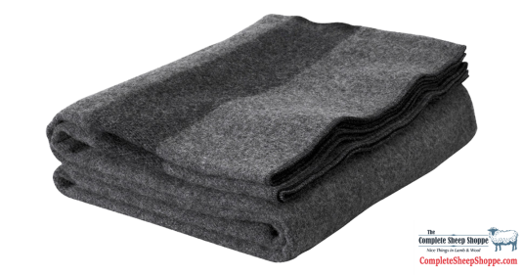
NOVELTY 2: SHEEP
Sheep live on the grounds
Wool insulation replenished
Supports Colorado sheep industry
Occupants will love the sheep
2018 ASHRAE LowDown Showdown Modeling Competition

Slide 10
TEAM WORK
Front-end loaded design
Multi-disciplinary collaboration
Diverse skill sets
Debate produced better ideas
Weekly collaboration meetings
2018 ASHRAE LowDown Showdown Modeling Competition

Slide 11
RESULTS SUMMARY
 | IP | SI
Total Energy Use [gal - Liter] | 773,460 | 226,679
Total Water Use [gal - Liter] | - | -
Total PV Production Use [kBtu - kWh] | 834,528 | 244,253
Total Energy & Water Cost [$] | 4,840 | 4,840
Total EUI [kBtu/ft² – kWh/m²] | 12.9 | 40.7
Total Energy Cost [$/ft² - $/m²] | .0.081 | 0.87
2018 ASHRAE LowDown Showdown Modeling Competition

Slide 12
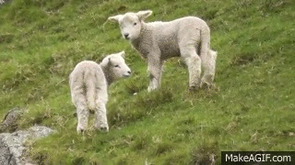
CONCLUSION
Workflow: taking energy modeling to the limit.
Design: precise occupant comfort and net zero.
Sheep: the occupants will love them. Who wouldn’t?
2018 ASHRAE LowDown Showdown Modeling Competition

